Slide 1


FULLSTACK INTENSIVE BOOTCAMP
Data Analyst
What is
Data Analyst?
Oleh: Muhammad Wahfiuddin Pradiwa
Mini Task

Slide 2
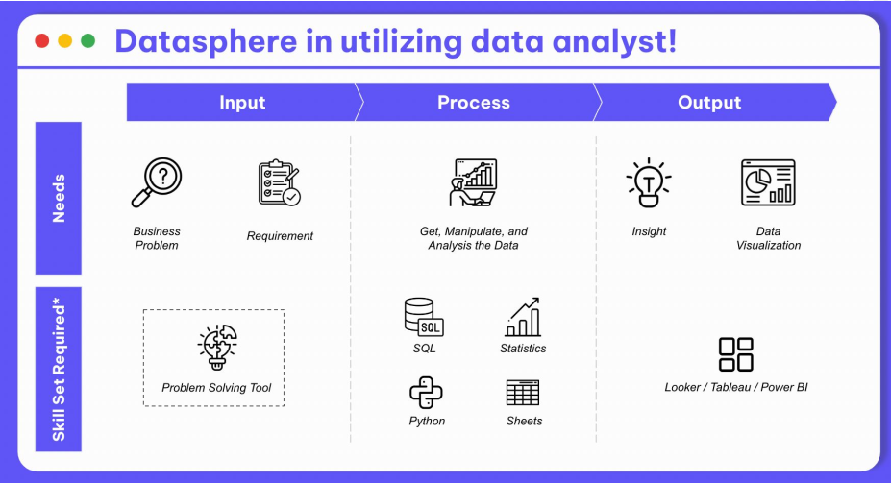

Course Summary
In data analytics, there is few skills should have like business problem, get data, data manipulation, data visualization and insight transfer.
Business problem should be quantitative and measureable, so we can create exact solution.
#RintisKarirImpian

Slide 3
15 MINS: LET’S DO THIS!
Develop your analysis framework that contained:
1. Problem Setting
Ideal Condition
Existing Condition
Gap
2. Problem Breakdown (to prioritize your problem solving process)
3. Problem Tree (to review all the possibility that able to become a root cause) - at least 3 point/ hypotheses for problem tree
#RintisKarirImpian

Slide 4
Answer
Here is Internet Service Provider (ISP) Company. Last month, the sales division do not reach the customer growth target even the customers is drop.
Ideal condition:
New customer is reach minimum 20 customers each month.
Gap:
There is not achieved target, needs 70 customer.
Existing condition:
Customer churn reach 50 in August 2023.
The company has a problem, there is the customers drop last month.
#RintisKarirImpian

Slide 5
Answer
Here is Internet Service Provider (ISP) Company. Last month, the sales division do not reach the customer growth target even the customers is drop.
Customers drop
Bad services
New competitor
Rising in prices
Hypotheses | Data | Source
Bad services | Internet downtime, average speed | Services division
Rising in prices | Pricing and services | Finance division
New competitor | Competitor, competitor prices and services | Survey
#RintisKarirImpian

Slide 6

Follow me!
Instagram :
Twitter :
LinkedIn :
Bootcamp Data Analysis
by @myskill.id

